Slide 1
Supplement sales prediction
Approach of solving this problem
Name – Akash Sanjay Wagh

Slide 2
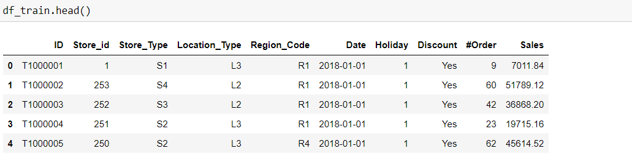
1.Understand data
In this problem we can data is continuous.
For this problem we need to use regression model.

Slide 3
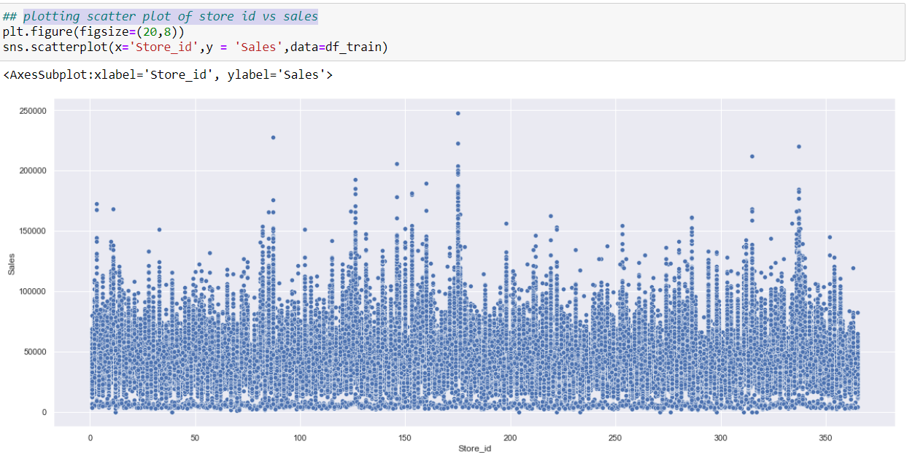
2.plotting scatter plot of store id vs sales

Slide 4
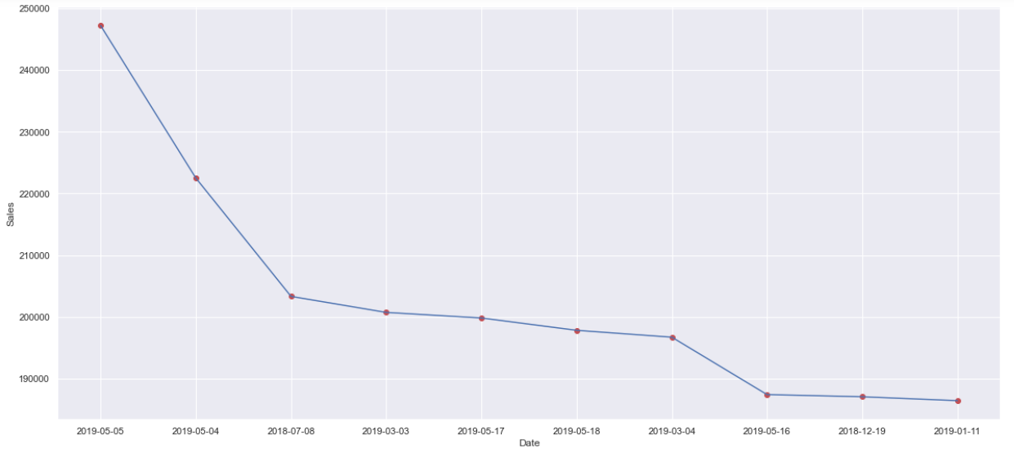
3. line plot of date vs sales above plot we can see in 2019-5-5 there was maximum sales near about 250000

Slide 5
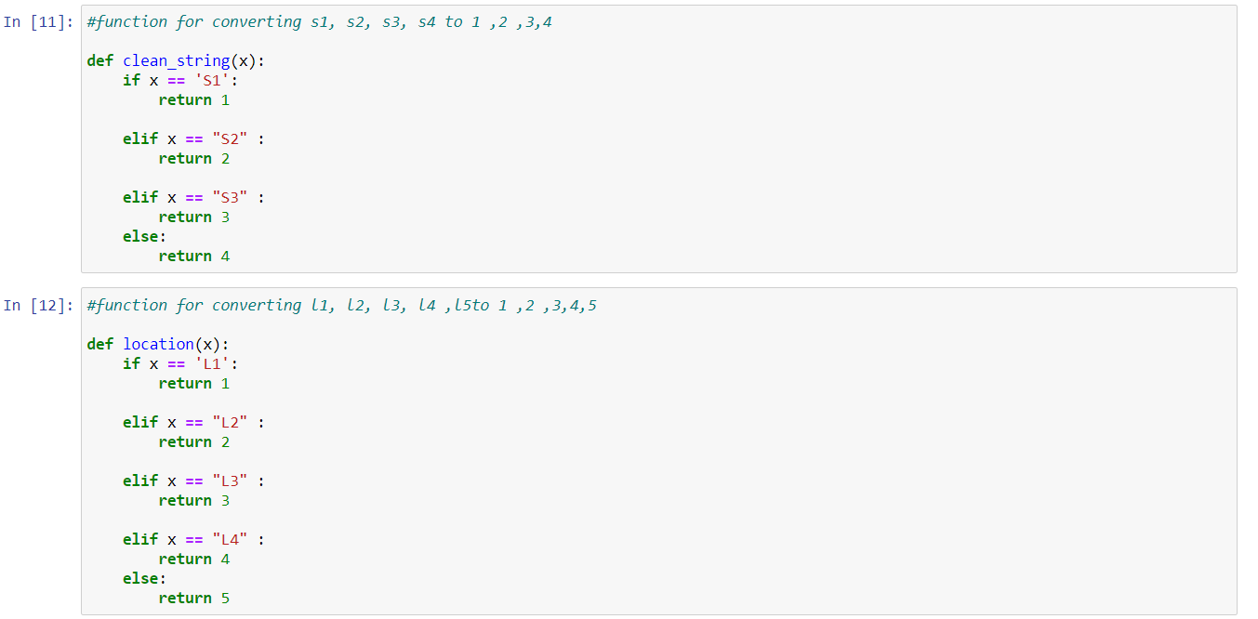
4.Function for converting Store Type, Location Type into numerical data
We know that model does not understand string so by using this function we are going to convert string into integer.

Slide 6
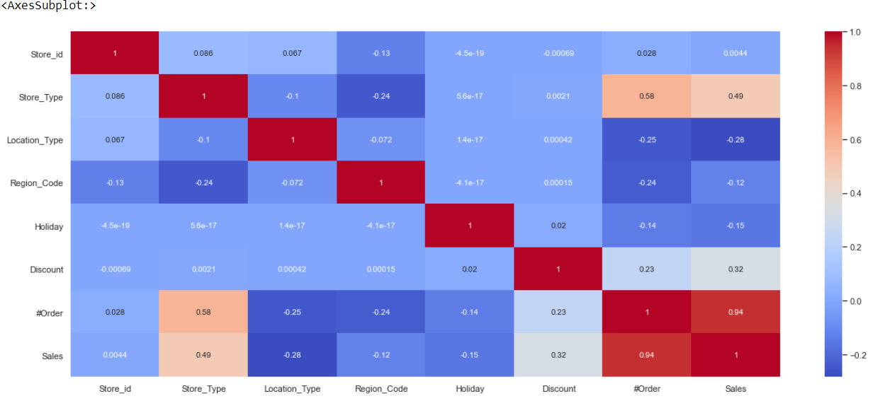
5. visulaising using correlation matrix – Discover relation from above graph we can see that for sales (store type )affect more which is +0.49 it means if store type better then sales also increases similarly Discount +0.32, location type -0.28,Region code -0.12,holiday -0.15

Slide 7
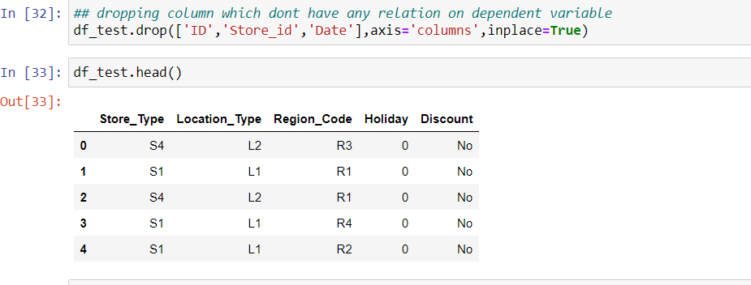
6.data-preprocessing / feature engineering
Dropping column which don’t have any relation.

Slide 8
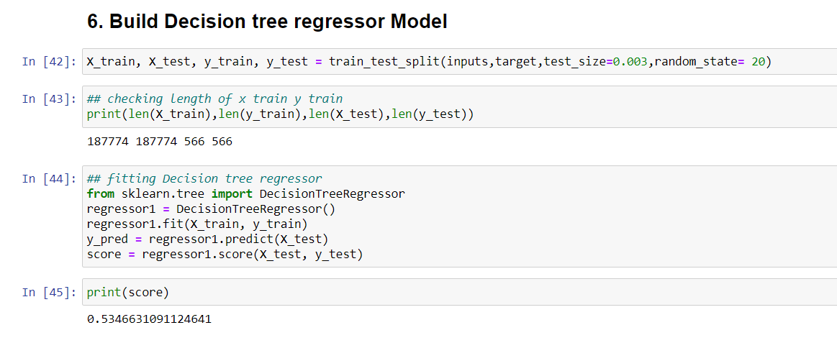
Decision tree regressor

Slide 9
Selection of best model for this dataset
Random Forest is suitable for situations when we have a large dataset
In the case of random forest, it ensembles multiple decision trees into its final decision.
Random forest can be used regression task (predict continuous outputs, such as price)

Slide 10
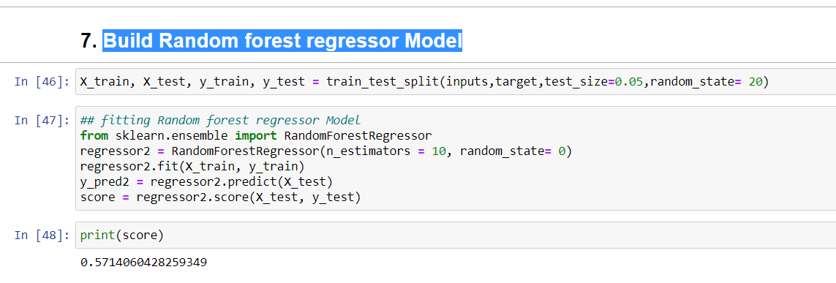
Build Random forest regressor Model

Slide 11
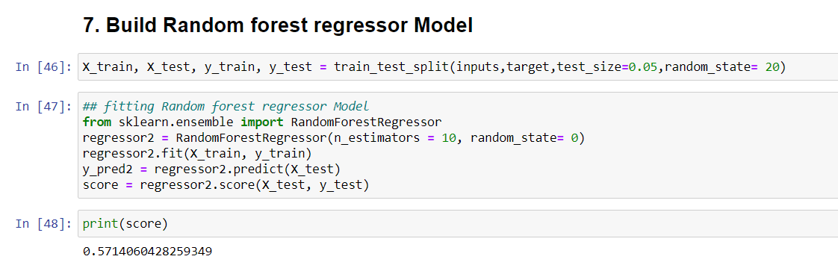
7.final model look like this model giving best accuracy that’s why, select for final model for this dataset.

Slide 12
conclusion
Conclusion - In this Supplement sales prediction problem with help of Random forest Regressor we got 57% accuracy.

